Slide 1


14. Web Python

Slide 2
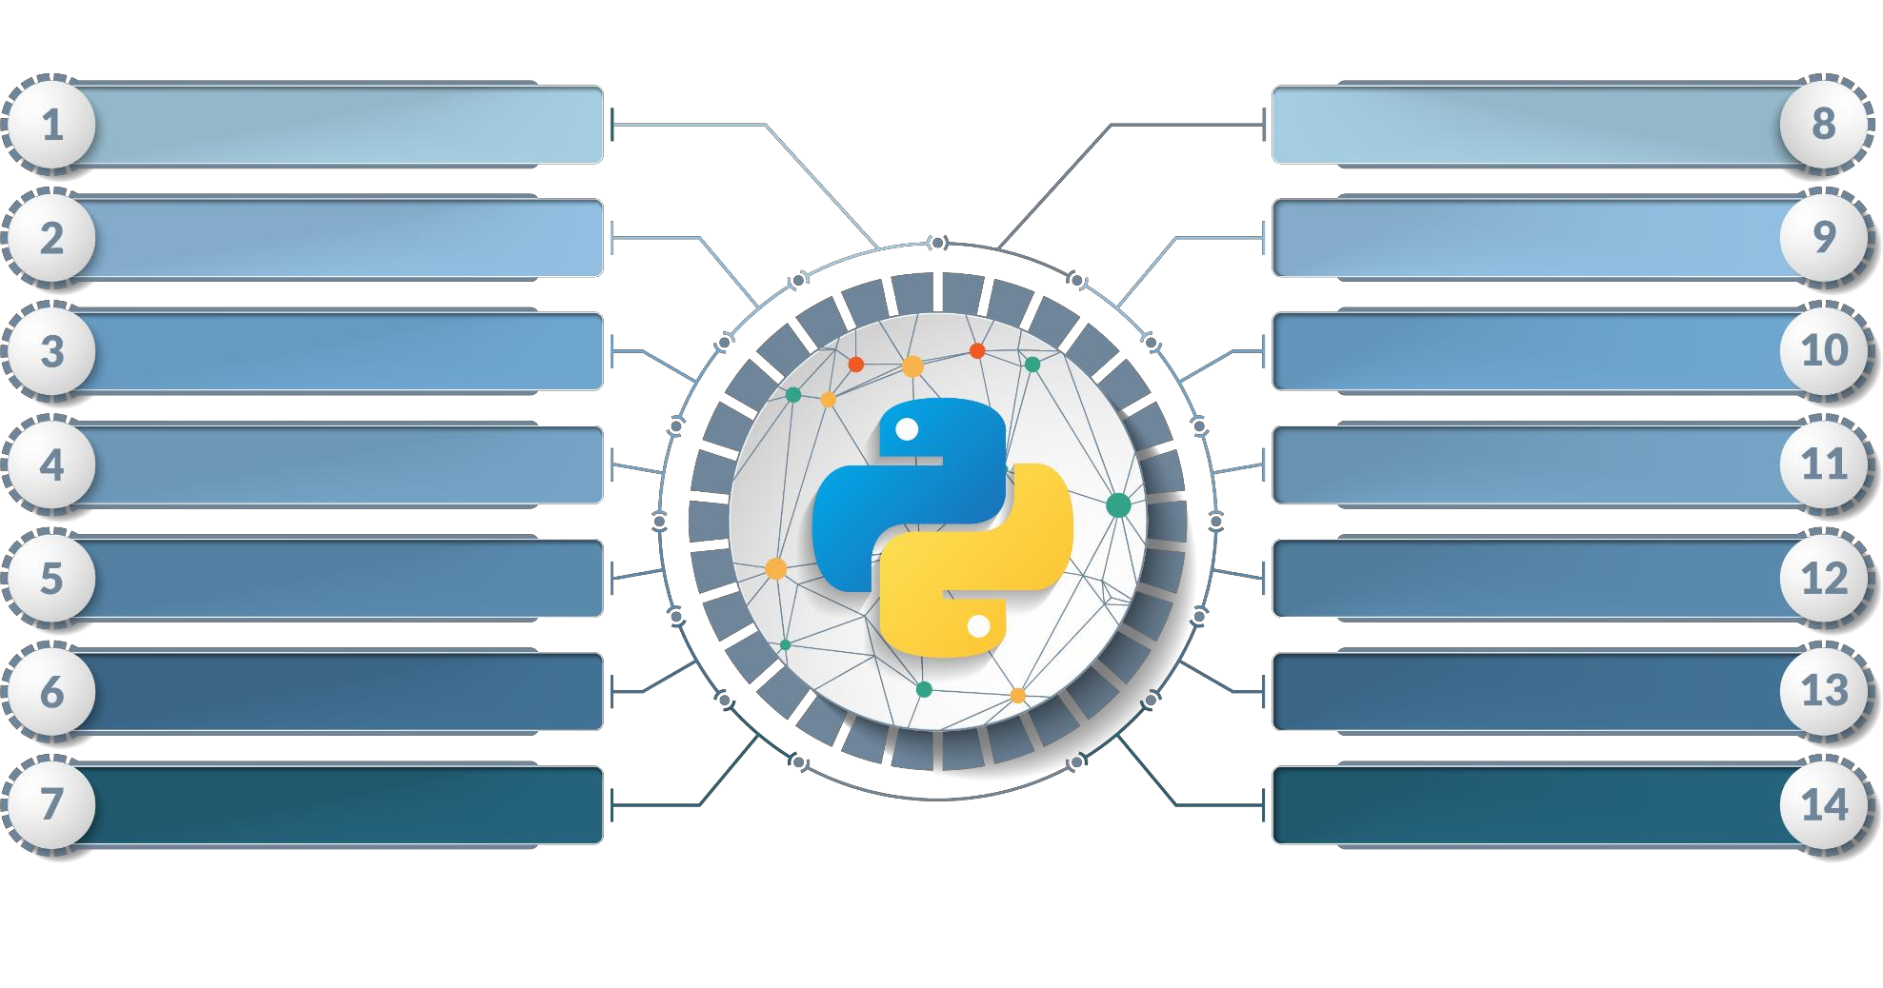


Course Outline
N
Introduction to Python
Functions, Modules & Packages
Basics of Python
OOPs & Exception Handling
Program Flow Control
File Handling
String Manipulation
Numpy, Pandas, Matplotlib, SciPy
List Manipulation
Database
Tuple, Set Manipulation
Networking & Multithreading
Dictionaries Manipulation
Web Python

Slide 3

Course Objectives
After completing this module, you should be able to:
Flask
Django
CGI

Slide 4



Flask

Slide 5

What is Web Application Framework?
Web Application Framework or simply Web Framework represents a collection of libraries and modules that enables a web application developer to write applications without having to bother about low-level details such as protocols, thread management etc.

Slide 6
Flask Framework
Flask is a web application framework written in Python. It is developed by Armin Ronacher, who leads an international group of Python enthusiasts named Pocco. Flask is based on the Werkzeug WSGI toolkit and Jinja2 template engine. Both are Pocco projects.
WSGI
Web Server Gateway Interface (WSGI) has been adopted as a standard for Python web application development. WSGI is a specification for a universal interface between the web server and the web applications.
Werkzeug
It is a WSGI toolkit, which implements requests, response objects, and other utility functions. This enables building a web framework on top of it. The Flask framework uses Werkzeug as one of its bases.
Jinga2
Jinga2 is a popular templating engine for Python. A web templating system combines a template with a certain data source to render dynamic web pages.
Flask is often referred to as a micro framework. It aims to keep the core of an application simple yet extensible. Flask does not have built-in abstraction layer for database handling, nor does it have form a validation support. Instead, Flask supports the extensions to add such functionality to the application.

Slide 7
Flask Environment
Install virtualenv for development environment
virtualenv is a virtual Python environment builder. It helps a user to create multiple Python environments side-by-side. Thereby, it can avoid compatibility issues between the different versions of the libraries.
The following command installs virtualenv
pip install virtualenv
On Windows, following can be used venv\scripts\activate
We are now ready to install Flask in this environment.
pip install Flask
The above command can be run directly, without virtual environment for system-wide installation

Slide 8
HTTP Methods
Http protocol is the foundation of data communication in world wide web. Different methods of data retrieval from specified URL are defined in this protocol.
The following table summarizes different http methods −
GET | Sends data in unencrypted form to the server. Most common method.
HEAD | Same as GET, but without response body
POST | Used to send HTML form data to server. Data received by POST method is not cached by server.
PUT | Replaces all current representations of the target resource with the uploaded content.
DELETE | Removes all current representations of the target resource given by a URL

Slide 9
Request Object
The data from a client’s web page is sent to the server as a global request object. In order to process the request data, it should be imported from the Flask module.
Important attributes of request object are listed below −
Form − It is a dictionary object containing key and value pairs of form parameters and their values.
args − parsed contents of query string which is part of URL after question mark (?).
Cookies − dictionary object holding Cookie names and values.
files − data pertaining to uploaded file.
method − current request method.

Slide 10
Sending Form Data to a Template
We have already seen that the http method can be specified in URL rule. The Form data received by the triggered function can collect it in the form of a dictionary object and forward it to a template to render it on a corresponding web page.
In the following example, ‘/’ URL renders a web page (student.html) which has a form. The data filled in it is posted to the ‘/result’ URL which triggers the result() function.
The results() function collects form data present in request.form in a dictionary object and sends it for rendering to result.html.
The template dynamically renders an HTML table of form data.

Slide 11
Cookies
A cookie is stored on a client’s computer in the form of a text file. Its purpose is to remember and track data pertaining to a client’s usage for better visitor experience and site statistics.
A Request object contains a cookie’s attribute. It is a dictionary object of all the cookie variables and their corresponding values, a client has transmitted. In addition to it, a cookie also stores its expiry time, path and domain name of the site.
In Flask, cookies are set on response object. Use make_response() function to get response object from return value of a view function. After that, use the set_cookie() function of response object to store a cookie.
Reading back a cookie is easy. The get() method of request.cookiesattribute is used to read a cookie.

Slide 12
Sessions
Unlike a Cookie, Session data is stored on server. Session is the time interval when a client logs into a server and logs out of it. The data, which is needed to be held across this session, is stored in a temporary directory on the server.
A session with each client is assigned a Session ID. The Session data is stored on top of cookies and the server signs them cryptographically. For this encryption, a Flask application needs a defined SECRET_KEY.
Session object is also a dictionary object containing key-value pairs of session variables and associated values.

Slide 13
Redirection
Flask class has a redirect() function. When called, it returns a response object and redirects the user to another target location with specified status code.
Prototype of redirect() function is as below − Flask.redirect(location, statuscode, response)
In the above function −
location parameter is the URL where response should be redirected.
statuscode sent to browser’s header, defaults to 302.
response parameter is used to instantiate response.

Slide 14
Redirection..
The following status codes are standardized −
HTTP_300_MULTIPLE_CHOICES
HTTP_301_MOVED_PERMANENTLY
HTTP_302_FOUND
HTTP_303_SEE_OTHER
HTTP_304_NOT_MODIFIED
HTTP_305_USE_PROXY
HTTP_306_RESERVED
HTTP_307_TEMPORARY_REDIRECT
The default status code is 302, which is for ‘found’.

Slide 15
Errors
Flask class has abort() function with an error code. Flask.abort(code)
The Code parameter takes one of following values −
400 − for Bad Request
401 − for Unauthenticated
403 − for Forbidden
404 − for Not Found
406 − for Not Acceptable
415 − for Unsupported Media Type
429 − Too Many Requests
Let us make a slight change in the login() function in the above code. Instead of re-displaying the login page, if ‘Unauthorized’ page is to be displayed, replace it with call to abort(401).

Slide 16
File Uploading
Handling file upload in Flask is very easy. It needs an HTML form with its enctype attribute set to ‘multipart/form-data’, posting the file to a URL. The URL handler fetches file from request.files[] object and saves it to the desired location.
Each uploaded file is first saved in a temporary location on the server, before it is actually saved to its ultimate location. Name of destination file can be hard-coded or can be obtained from filename property of request.files[file]object. However, it is recommended to obtain a secure version of it using the secure_filename() function.

Slide 17
File Uploading
It is possible to define the path of default upload folder and maximum size of uploaded file in configuration settings of Flask object.
app.config[‘UPLOAD_FOLDER’] Defines path for upload folder
app.config[‘MAX_CONTENT_PATH’] Specifies maximum size of file to be uploaded – in bytes

Slide 18
Flask Extensions

Slide 19
Flask Extensions
Flask is often referred to as a micro framework, because a core functionality includes WSGI and routing based on Werkzeug and template engine based on Jinja2. In addition, Flask framework has support for cookie and sessions as well as web helpers like JSON, static files etc. Obviously, this is not enough for the development of a full-fledged web application. This is where the Flask extensions come in picture. Flask extensions give extensibility to Flask framework.
There are a large number of Flask extensions available. A Flask extension is a Python module, which adds specific type of support to the Flask application. Flask Extension Registry is a directory of extensions available. The required extension can be downloaded by pip utility.
We will discuss the following important Flask extensions −
Flask Mail − provides SMTP interface to Flask application
Flask WTF − adds rendering and validation of WTForms
Flask SQLAlchemy − adds SQLAlchemy support to Flask application
Flask Sijax − Interface for Sijax - Python/jQuery library that makes AJAX easy to use in web applications

Slide 20
Flask Extensions..
Each type of extension usually provides extensive documentation about its usage. Since an extension is a Python module, it needs to be imported for it to be used. Flask extensions are generally named as flask-foo. To import, from flask_foo import [class, function]
For versions of Flask later than 0.7, you can also use the syntax − from flask.ext import foo
For this usage, a compatibility module needs to be activated. It can be installed by running flaskext_compat.py
import flaskext_compat
flaskext_compat.activate()
from flask.ext import foo

Slide 21
Flask Mail

Slide 22
Flask Mail
A web based application is often required to have a feature of sending mail to the users/clients. Flask-Mail extension makes it very easy to set up a simple interface with any email server.
At first, Flask-Mail extension should be installed with the help of pip utility. pip install Flask-Mail
Then Flask-Mail needs to be configured by setting values of the following application parameters.
1.MAIL_SERVER-> Name/IP address of email server
2.MAIL_PORT-> Port number of server used
3.MAIL_USE_TLS->Enable/disable Transport Security Layer encryption
4.MAIL_USE_SSL->Enable/disable Secure Sockets Layer encryption

Slide 23
Flask Mail..
Then Flask-Mail needs to be configured by setting values of the following application parameters.
1.MAIL_SERVER-> Name/IP address of email server
2.MAIL_PORT-> Port number of server used
3.MAIL_USE_TLS->Enable/disable Transport Security Layer encryption
4.MAIL_USE_SSL->Enable/disable Secure Sockets Layer encryption
5.MAIL_DEBUG->Debug support. Default is Flask application’s debug status
6.MAIL_USERNAME->User name of sender
7.MAIL_PASSWORD->password of sender
8.MAIL_DEFAULT_SENDER->sets default sender
9.MAIL_MAX_EMAILS->Sets maximum mails to be sent
10.MAIL_SUPPRESS_SEND->Sending suppressed if app.testing set to true
11.MAIL_ASCII_ATTACHMENTS->If set to true, attached filenames converted to ASCII

Slide 24
Flask Mail – Mail Class
It manages email-messaging requirements. The class constructor takes the following form −
flask-mail.Mail(app = None)
The Constructor takes the Flask application object as a parameter.
Methods of Mail class
1.send()->Sends contents of Message class object
2.connect()->Opens connection with mail host
3.send_message()->Sends message object

Slide 25
Flask Mail – Message Class
It encapsulates an email message. Message class constructor has several parameters −
flask-mail.Message(subject, recipients, body, html, sender, cc, bcc,
reply-to, date, charset, extra_headers, mail_options, rcpt_options)
Message class methods
attach() − adds an attachment to message.
This method takes the following parameters −
filename − name of file to attach
content_type − MIME type of file
data − raw file data
disposition − content disposition, if any.
add_recipient() − adds another recipient to message

Slide 26
Flask WTF

Slide 27
WTForms Overview
One of the essential aspects of a web application is to present a user interface for the user. HTML provides a <form> tag, which is used to design an interface. A Form’s elements such as text input, radio, select etc. can be used appropriately.
Data entered by a user is submitted in the form of Http request message to the server side script by either GET or POST method.
The Server side script has to recreate the form elements from http request data. So in effect, form elements have to be defined twice – once in HTML and again in the server side script.
Another disadvantage of using HTML form is that it is difficult (if not impossible) to render the form elements dynamically. HTML itself provides no way to validate a user’s input.

Slide 28
WTForms Overview
This is where WTForms, a flexible form, rendering and validation library comes handy. Flask-WTF extension provides a simple interface with this WTForms library.
Using Flask-WTF, we can define the form fields in our Python script and render them using an HTML template. It is also possible to apply validation to the WTF field.
First, Flask-WTF extension needs to be installed. pip install flask-WTF
The installed package contains a Form class, which has to be used as a parent for user- defined form.
WTforms package contains definitions of various form fields

Slide 29
WTF – Standard Form Fields
TextField -> Represents <input type = 'text'> HTML form element
BooleanField-> Represents <input type = 'checkbox'> HTML form element
DecimalField-> Textfield for displaying number with decimals
IntegerField-> TextField for displaying integer
RadioField-> Represents <input type = 'radio'> HTML form element
SelectField-> Represents select form element
TextAreaField-> Represents <textarea> html form element
PasswordField-> Represents <input type = 'password'> HTML form element
SubmitField-> Represents <input type = 'submit'> form element

Slide 30
WTF - Validator
WTForms package also contains validator class. It is useful in applying validation to form fields.
DataRequired->Checks whether input field is empty
Email->Checks whether text in the field follows email ID conventions
IPAddress->Validates IP address in input field
Length->Verifies if length of string in input field is in given range
NumberRange->Validates a number in input field within given range
URL-Validates URL entered in input field

Slide 31
WTF – Validator..
We shall now apply ‘DataRequired’ validation rule for the name field in contact form.
name = TextField("Name Of Student",[validators.Required("Please enter your name.")])
The validate() function of form object validates the form data and throws the validation errors if validation fails. The Error messages are sent to the template. In the HTML template, error messages are rendered dynamically.
{% for message in form.name.errors %}
{{ message }}
{% endfor %}

Slide 32
Flask SQLite

Slide 33
SQLite Overview
Python has an in-built support for SQlite. SQlite3 module is shipped with Python distribution. For a detailed tutorial on using SQLite database in Python, please refer to this link. In this section we shall see how a Flask application interacts with SQLite.
Create an SQLite database ‘database.db’ and create a students’ table in it.
import sqlite3
conn = sqlite3.connect('database.db')
print "Opened database successfully";
conn.execute('CREATE TABLE students (name TEXT, addr TEXT, city TEXT, pin TEXT)')
print "Table created successfully";
conn.close()

Slide 34
Flask SQLAlchemy

Slide 35
SQLAlchemy Overview
Using raw SQL in Flask web applications to perform CRUD operations on database can be tedious. Instead, SQLAlchemy, a Python toolkit is a powerful OR Mapper that gives application developers the full power and flexibility of SQL. Flask-SQLAlchemy is the Flask extension that adds support for SQLAlchemy to your Flask application.
What is ORM (Object Relation Mapping)?
Most programming language platforms are object oriented. Data in RDBMS servers on the other hand is stored as tables. Object relation mapping is a technique of mapping object parameters to the underlying RDBMS table structure. An ORM API provides methods to perform CRUD operations without having to write raw SQL statements.
To Install Flask-SQLAlchemy extension ->pip install flask-sqlalchemy

Slide 36
Flask Sijax

Slide 37
Sijax Overview
Sijax stands for ‘Simple Ajax’ and it is a Python/jQuery library designed to help you easily bring Ajax to your application. It uses jQuery.ajax to make AJAX requests.
Installation
Installation of Flask-Sijax is easy. pip install flask-sijax
Configuration
SIJAX_STATIC_PATH − the static path where you want the Sijax javascript files to be mirrored. The default location is static/js/sijax. In this folder, sijax.js and json2.js files are kept.
SIJAX_JSON_URI − the URI to load the json2.js static file from
Sijax uses JSON to pass the data between the browser and the server. This means that the browsers need either to support JSON natively or get JSON support from the json2.js file.

Slide 38

Django

Slide 39
Django Basics

Slide 40
Django Overview
Django is a high-level Python web framework that encourages rapid development and clean, pragmatic design. Django makes it easier to build better web apps quickly and with less code.
History of Django
2003 − Started by Adrian Holovaty and Simon Willison as an internal project at the Lawrence Journal-World newspaper.
2005 − Released July 2005 and named it Django, after the jazz guitarist Django Reinhardt.
2005 − Mature enough to handle several high-traffic sites.
Current − Django is now an open source project with contributors across the world.

Slide 41
Django Design Principles
Django comes with the following design philosophies −
Loosely Coupled − Django aims to make each element of its stack independent of the others.
Less Coding − Less code so in turn a quick development.
Don't Repeat Yourself (DRY) − Everything should be developed only in exactly one place instead of repeating it again and again.
Fast Development − Django's philosophy is to do all it can to facilitate hyper-fast development.
Clean Design − Django strictly maintains a clean design throughout its own code and makes it easy to follow best web-development practices.

Slide 42
Advantages of Django
Object-Relational Mapping (ORM) Support − Django provides a bridge between the data model and the database engine, and supports a large set of database systems including MySQL, Oracle, Postgres, etc. Django also supports NoSQL database through Django-nonrel fork. For now, the only NoSQL databases supported are MongoDB and google app engine.
Multilingual Support − Django supports multilingual websites through its built-in internationalization system. So you can develop your website, which would support multiple languages.
Framework Support − Django has built-in support for Ajax, RSS, Caching and various other frameworks.
Administration GUI − Django provides a nice ready-to-use user interface for administrative activities.
Development Environment − Django comes with a lightweight web server to facilitate end-to-end application development and testing.

Slide 43
Django Pattern

Slide 44
Django Pattern
Django is a Python web framework. And like most modern framework, Django supports the MVC pattern.
MVC Pattern
When talking about applications that provides UI (web or desktop), we usually talk about MVC architecture. And as the name suggests, MVC pattern is based on three components: Model, View, and Controller.
DJANGO MVC - MVT Pattern
The Model-View-Template (MVT) is slightly different from MVC. In fact the main difference between the two patterns is that Django itself takes care of the Controller part (Software Code that controls the interactions between the Model and View), leaving us with the template. The template is a HTML file mixed with Django Template Language (DTL).

Slide 45
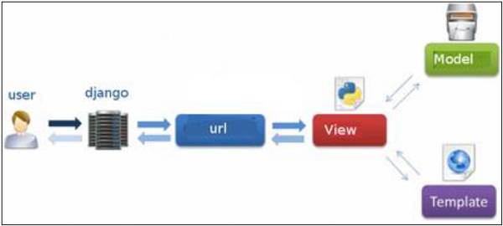
Django Pattern..
The following diagram illustrates how each of the components of the MVT pattern interacts with each other to serve a user request −
The developer provides the Model, the view and the template then just maps it to a URL and Django does the magic to serve it to the user.

Slide 46
Common Gateway Interface

Slide 47
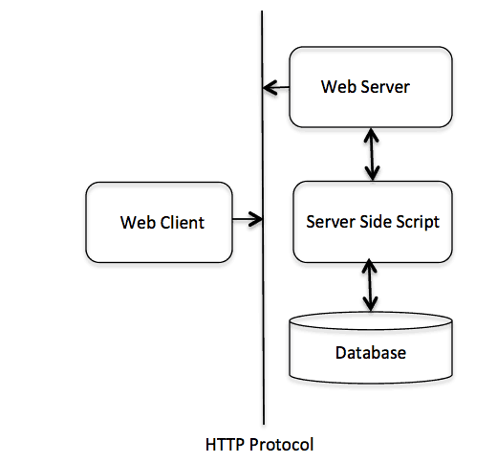
What is CGI?
The Common Gateway Interface, or CGI, is a standard for external gateway programs to interface with information servers such as HTTP servers.
The current version is CGI/1.1 and CGI/1.2 is under progress.

Slide 48
What is Web Browsing?
To understand the concept of CGI, let us see what happens when we click a hyper link to browse a particular web page or URL.
Your browser contacts the HTTP web server and demands for the URL, i.e., filename.
Web Server parses the URL and looks for the filename. If it finds that file then sends it back to the browser, otherwise sends an error message indicating that you requested a wrong file.
Web browser takes response from web server and displays either the received file or error message.
However, it is possible to set up the HTTP server so that whenever a file in a certain directory is requested that file is not sent back; instead it is executed as a program, and whatever that program outputs is sent back for your browser to display. This function is called the Common Gateway Interface or CGI and the programs are called CGI scripts. These CGI programs can be a Python Script, PERL Script, Shell Script, C or C++ program, etc.,

Slide 49
Common Gateway Interface Setup

Slide 50
Web Server Support and Configuration
Before you proceed with CGI Programming, make sure that your Web Server supports CGI and it is configured to handle CGI Programs. All the CGI Programs to be executed by the HTTP server are kept in a pre-configured directory. This directory is called CGI Directory and by convention it is named as /var/www/cgi-bin. By convention, CGI files have extension as. cgi, but you can keep your files with python extension .py as well.
By default, the Linux server is configured to run only the scripts in the cgi-bin directory in /var/www. If you want to specify any other directory to run your CGI scripts, comment the following lines in the httpd.conf file −
Here, we assume that you have Web Server up and running successfully and you are able to run any other CGI program like Perl or Shell, etc.
<Directory "/var/www/cgi-bin"> AllowOverride None
Options ExecCGI
Order allow,deny
Allow from all </Directory>
<Directory "/var/www/cgi-bin"> Options All </Directory>

Slide 51
Demo Hello World – CGI Program

Slide 52
Hello World – hello.py
#!/usr/bin/python
print "Content-type:text/html\r\n\r\n"
print '<html>' print '<head>'
print '<title>Hello Word - First CGI Program</title>'
print '</head>' print '<body>'
print '<h2>Hello Word! This is my first CGI program</h2>'
print '</body>' print '</html>'
Output - Hello Word! This is my first CGI program

Slide 53
Header – CGI Program

Slide 54
HTTP Header
Content-type:
A MIME string defining the format of the file being returned. Example is Content-type:text/html
Expires: Date:
The date the information becomes invalid. It is used by the browser to decide when a page needs to be refreshed. A valid date string is in the format 01 Jan 1998 12:00:00 GMT.
Location: URL
The URL that is returned instead of the URL requested. You can use this field to redirect a request to any file.
Last-modified: Date
The date of last modification of the resource.
Content-length: N
The length, in bytes, of the data being returned. The browser uses this value to report the estimated download time for a file.
Set-Cookie: String
Set the cookie passed through the string

Slide 55
CGI Environment Variables

Slide 56
CGI – Environment Variables
All the CGI programs have access to the following environment variables. These variables play an important role while writing any CGI program.
CONTENT_TYPE
The data type of the content. Used when the client is sending attached content to the server. For example, file upload.
CONTENT_LENGTH
The length of the query information. It is available only for POST requests.
HTTP_COOKIE
Returns the set cookies in the form of key & value pair.
HTTP_USER_AGENT
The User-Agent request-header field contains information about the user agent originating the request. It is name of the web browser.

Slide 57
CGI – Environment Variables
PATH_INFO
The path for the CGI script.
QUERY_STRING
The URL-encoded information that is sent with GET method request.
REMOTE_ADDR
The IP address of the remote host making the request. This is useful logging or for authentication.
REMOTE_HOST
The fully qualified name of the host making the request. If this information is not available, then REMOTE_ADDR can be used to get IR address.
REQUEST_METHOD
The method used to make the request. The most common methods are GET and POST.

Slide 58
CGI – Environment Variables
SCRIPT_FILENAME
The full path to the CGI script.
SCRIPT_NAME
The name of the CGI script.
SERVER_NAME
The server's hostname or IP Address
SERVER_SOFTWARE
The name and version of the software the server is running.

Slide 59
Get & Post Method

Slide 60
Get Method
The GET method sends the encoded user information appended to the page request. The page and the encoded information are separated by the ? character as follows −
The GET method is the default method to pass information from browser to web server and it produces a long string that appears in your browser's Location:box.
Never use GET method if you have password or other sensitive information to pass to the server. The GET method has size limitation: only 1024 characters can be sent in a request string.
The GET method sends information using QUERY_STRING header and will be accessible in your CGI Program through QUERY_STRING environment variable.
You can pass information by simply concatenating key and value pairs along with any URL or you can use HTML <FORM> tags to pass information using GET method.
http://www.test.com/cgi-bin/hello.py?key1=value1&key2=value2

Slide 61
Post Method
A generally more reliable method of passing information to a CGI program is the POST method. This packages the information in exactly the same way as GET methods, but instead of sending it as a text string after a ? in the URL it sends it as a separate message. This message comes into the CGI script in the form of the standard input.

Slide 62
CGI - Samples

Slide 63
Samples
Get Method
Post Method
Checkbox
Radio Button
Text area
Dropdown box
Cookies (Setting & Retrieving)
File Upload
File Download
Practice
CGI Samples

Slide 64

Summary
In this module, you should have learnt:
Flask
Django
CGI

Slide 65


Congratulation
Python – Web Python
You have successfully completed –
Web Python Session

Slide 66





Great, You will be the
Python Champion
Okay, I clearly understand the Web Python
What Next?

Slide 67
Congratulation Champion
Python Champion
You have successfully completed –
Python Champion Course

Slide 68



Slide 69


Slide 70


Slide 71


